Slide 1


A Presentation on
“Sign Language Recognition”
e-DBDA
2021
Guide
Mr. Tilekar A.
Student
Apurva Shikhare - 1301
Pooja Dhote - 1340
INSTITUTES FOR ADVANCED COMPUTING AND SOFTWARE DEVELOPMENT AKURDI, PUNE

Slide 2
CONTENTS
OBJECTIVE
INTRODUCTION
METHODOLOGY
REQUIREMENTS
TECHNOLOGY
DIAGRAM
SCREENSHOTS
ADVANTAGES
APPLICATION
FUTURE SCOPE
CONCLUSION
REFERANCES

Slide 3
OBJECTIVE
The main objective is to translate sign language to text.
This leads to the elimination of the middle person who generally acts as a medium of translation.
This can be very helpful for the deaf and dumb people in communicating with others.

Slide 4
INTRODUCTION
Dumb people are usually deprived of normal communication with other people in the society. Also normal people find it difficult to understand and communicate with them.
Detects Alphabets from A-Z and Numbers from 0-9.
It uses hand gestures.

Slide 5
METHODOLOGY
Analysis of dataset
Training a CNN on the dataset
Predicting the data

Slide 6
REQUIREMENT
1. Hardware Requirement :
Computer
RAM 4GB
Power supply 18V
Camera
2. Software Requirement :
Anaconda Software
Python 2.7 or Above
Operating System

Slide 7
TECHNOLOGY
1. Python Libraries:
OpenCV
Keras
Numpy
Matplotlib
Tensorflow
IDE (Jupyter)
2. Model:
Sequential Model of Keras
3. Algorithm:
Convolution Nueral Network

Slide 8
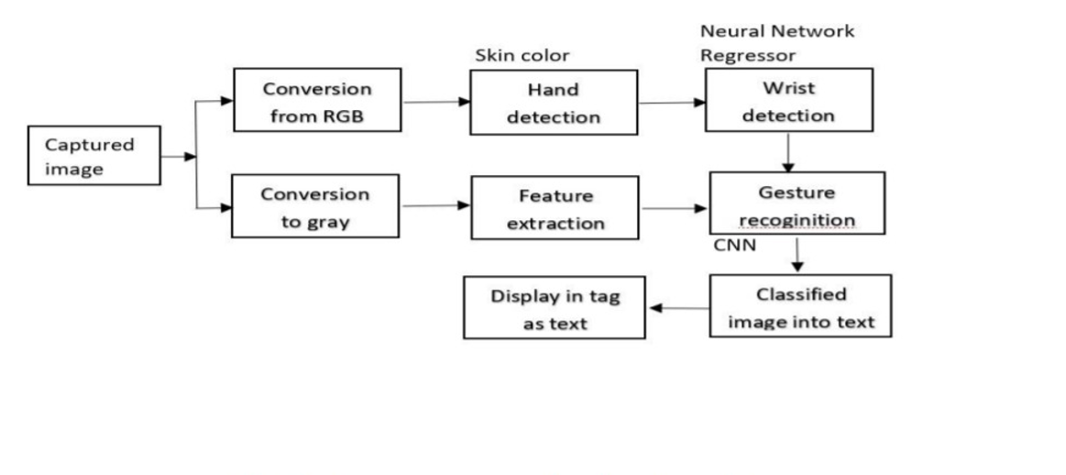
DIAGRAM

Slide 9
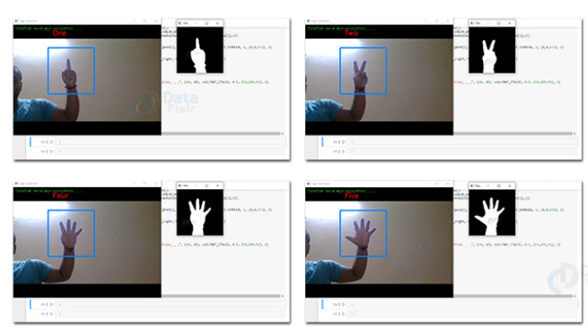
Screenshots

Slide 10
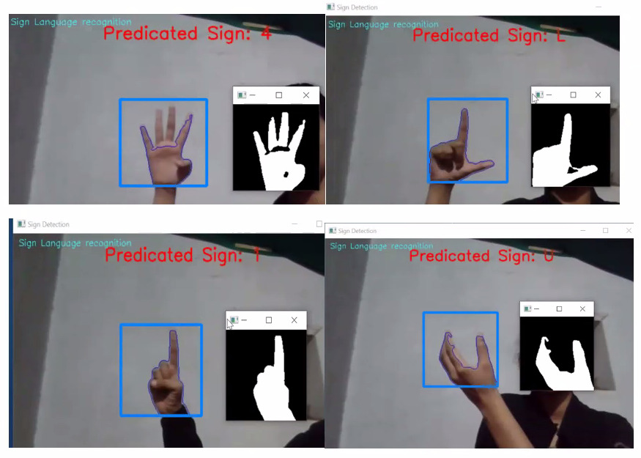
Screenshots

Slide 11
ADVANTAGES
Helps the deaf and the dumb to communicate with the others as well as amongst themselves.
Helps in the process of social inclusion of those that suffer from hearing impairment.
Enhances the level of confidence among the disabled.

Slide 12
APPLICATIONS
Makes life easier for the deaf.
Provides a chance to the deaf children to educate themselves.

Slide 13
FUTURE SCOPE
We are planning to achieve higher accuracy even in case of complex backgrounds by trying out various background subtraction algorithms.
We are also thinking of improving the preprocessing to predict gestures in low light conditions with a higher accuracy.

Slide 14
CONCLUSION
Our project aims to make communication simpler between deaf and dumb people by introducing Computer in communication path so that sign language can be automatically captured, recognized, translated to text and displayed it on LCD.
Converting RGB image to binary and matching it with database using a comparing algorithm is simple, efficient and robust technique. This technique is sufficiently accurate to convert sign language into text.

Slide 15
REFERENCES
Pigou L., Dieleman S., Kindermans PJ., Schrauwen B. (2015) Sign Language Recognition Using Convolutional Neural Networks. In: Agapito L., Bronstein M., Rother C. (eds) Computer Vision - ECCV 2014 Workshops. ECCV 2014. Lecture Notes in Computer Science, vol 8925. Springer, Cham.
Divya Deora and Nikesh Bajaj, "Indian Sign Language Recognition", in Emerging Technology Trends in Electronics, Communication and Networking (ET2ECN), 2012 1st International Conf. , 2012. doi: 10.1109/ET2ECN.2012.6470093 https://docs.opencv.org/3.4.15/d3/dc0/group__imgproc__shape.html#gga4303f45752694956374734a03c54d5ffa5f2883048e654999209f88ba04c302f5
https://www.programcreek.com/python/example/89428/cv2.absdiff

Slide 16
THANK YOU

